Slide 1



Praktična delavnica Docker & Kubernetes
November 2022
www.ict-academy.eu

Slide 2
AVTORSKE PRAVICE GRADIVA
Vsa gradiva usposabljanja Docker & Kubernetes, september 2020 (predavanja, demonstracije, vaje), so last Univerze v Ljubljani, Fakultete za elektrotehniko (UL FE).
Uporaba je dovoljena izključno v okviru usposabljanja.
Noben del gradiva ne sme biti reproduciran, shranjen ali prepisan v katerikoli obliki oziroma na katerikoli način (elektronsko, mehansko, s fotokopiranjem, snemanjem) brez predhodnega pisnega dovoljenja.
Vse pravice pridržane. © september 2020, UL FE.

Slide 3

UL Fakulteta za elektrotehniko
2.200+ študentov
300+ raziskovalcev in akademskega osebja
50 % sredstev pridobljenih na trgu

Slide 4


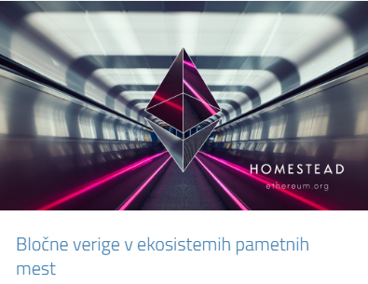
Laboratorij za telekomunikacije Laboratorij za multimedijo

Slide 5
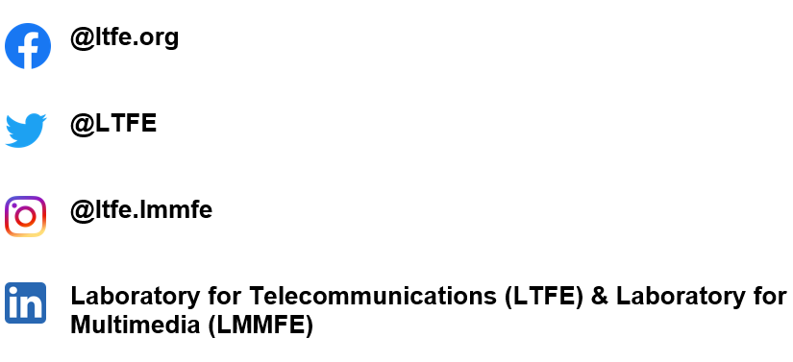
Najdete nas tudi na:

Slide 6
Področja uporabe IKT/IoT
2010
Networks, Telecommunications, ICT
2020
eHealth and Wellbeing
Industry 4.0
Public safety
Innovations
...
ICT
...
ICT
ICT
ICT
Transport
Education and Training
Energy
Turism
ICT
ICT
ICT
ICT

Slide 7







Aktivnosti (1)
Usposabljanja za podjetja in organizacije
IKT-akademija, IoT-akademija, Digitalna akademija
Multimedijsko podprto učenje, E-Cho
Prototipiranje, Makerlab/Openlab/FabLab
Rešitve IKT/IoT za različna področja
AR/VR/360º za športne dogodke in dostopnost
Odprto inoviranje: Pametno ogledalo, Gnezdo, SmartFroc
Digitalno inovacijsko stičišče
Sodelovanje in povezovanje s študenti

Slide 8







Aktivnosti (2)
Pilotne in demonstracijske rešitve
Rešitve za pametna mesta in vasi
112 aplikacije (4G/5G/VR)
IoT in omrežja za ceste
Blockchain IoT in PoE
Kibernetska varnost; honeypoti ter analitika vdorov
Razvojni projekti
Signalizacije in kontrolna ravnina
Smartgrid komunikacije in IoT
Testiranje omrežij
Vsebine AR/VR, 360º

Slide 9
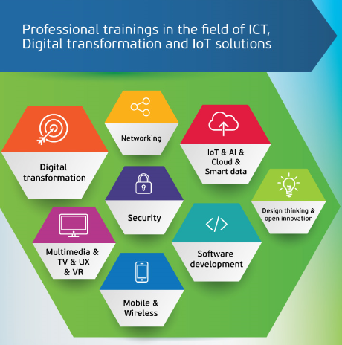

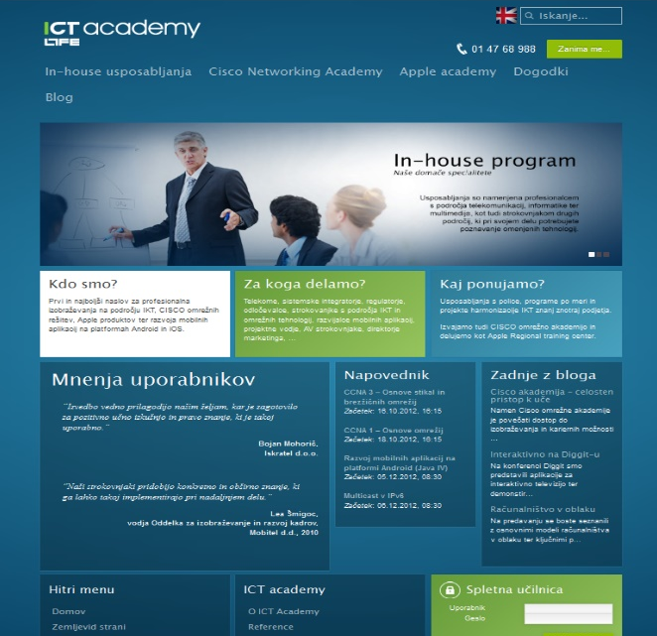
www.ict-academy.eu

Slide 10

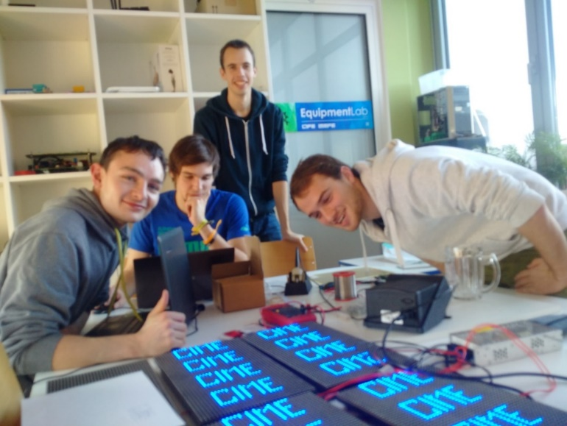
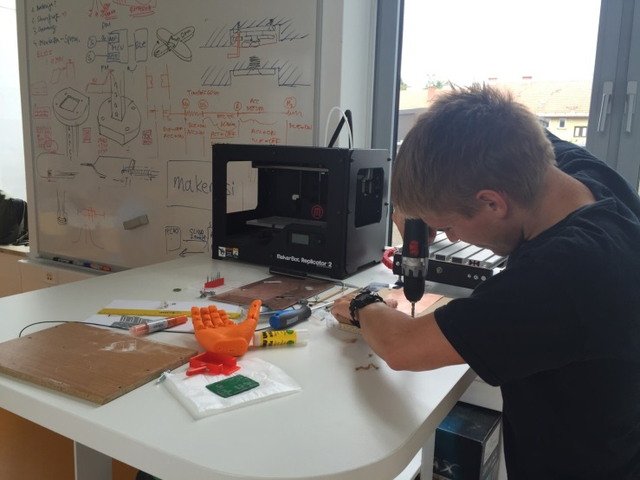
Prototipiranje, MakerLab
Poudarek na IoT
Razvoj, inovacije
Learning by doing

Slide 11
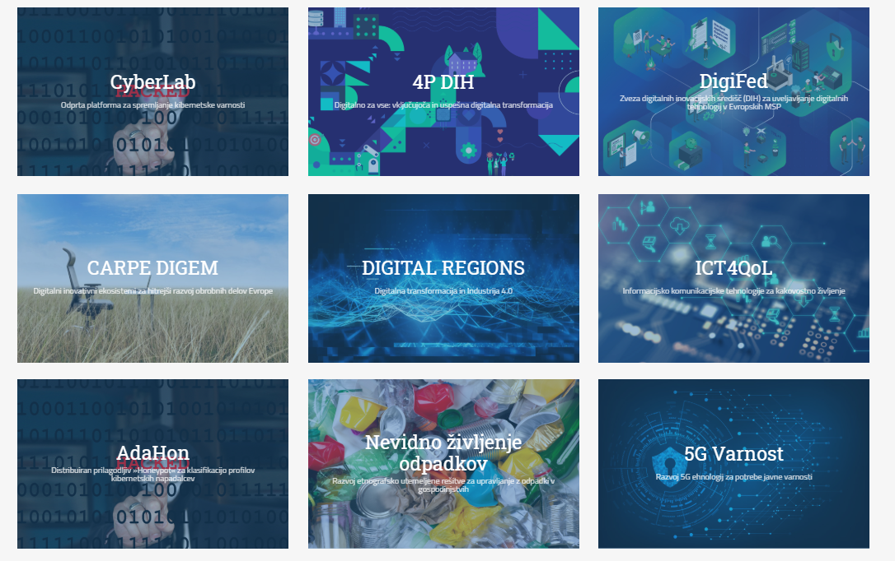
Pilotne in demonstracijske rešitve, R&D

Slide 12
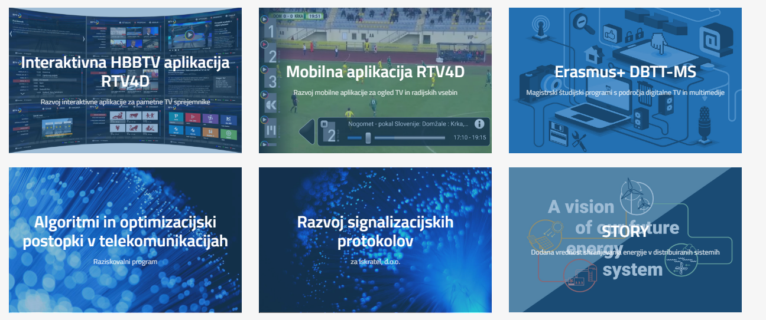

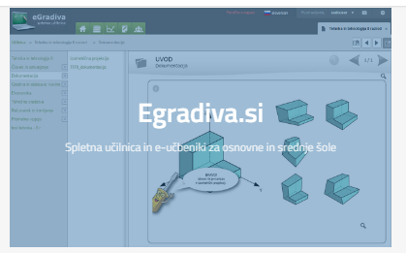
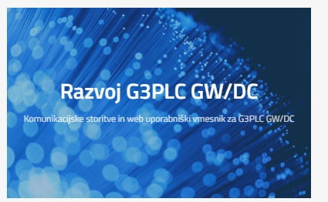
Razvojni projekti

Slide 13
Predpriprava
Predpripravljena virtualka
Razdelimo uporabniška imena in gesla
Prenesemo gradiva iz Git-a:
git clone https://github.com/icta-tecaji/docker-k8s-public.git

Slide 14

Intro To Docker

Slide 15
Docker overview
Docker is an open platform for developing, shipping, and running applications.
Docker is a platform for running applications in lightweight units called containers.
Docker enables you to separate your applications from your infrastructure so you can deliver software quickly
Reduce the delay between writing code and running it in production
People’s number one “most wanted” technology

Slide 16
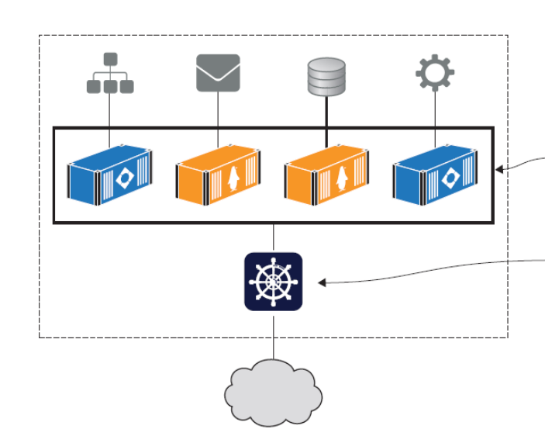
Why are containers and Docker so important?
Migrating apps to the cloud
Modernizing legacy apps
Building new cloud-native apps
Technical innovation: Serverless and more
Docker provides an abstraction
Protecting your computer
Improving portability
Getting organized
Source: Learn Docker in a Month of Lunches, ELTON STONEMAN

Slide 17
Installing Docker
Docker Desktop - Docker Desktop is an easy-to-install application for your Mac or Windows environment that enables you to build and share containerized applications and microservices.
Docker Engine - Docker Engine is an open source containerization technology for building and containerizing your applications. Docker Engine acts as a client-server application with:
Install Docker Engine on Ubuntu
Post-installation steps for Linux
[Optional] Manage Docker as a non-root user -> Security risks!
Configure Docker to start on boot
Verifying your Docker setup: docker version

Slide 18
Running Hello World in a container
And Docker images can be packaged to run on any computer that supports Docker, which makes the app completely portable — portability is one of Docker’s key benefits.
Example: Running multiple NGINX instances
About Docker Company

Slide 19
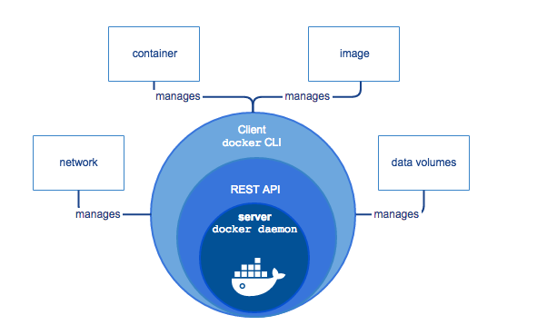
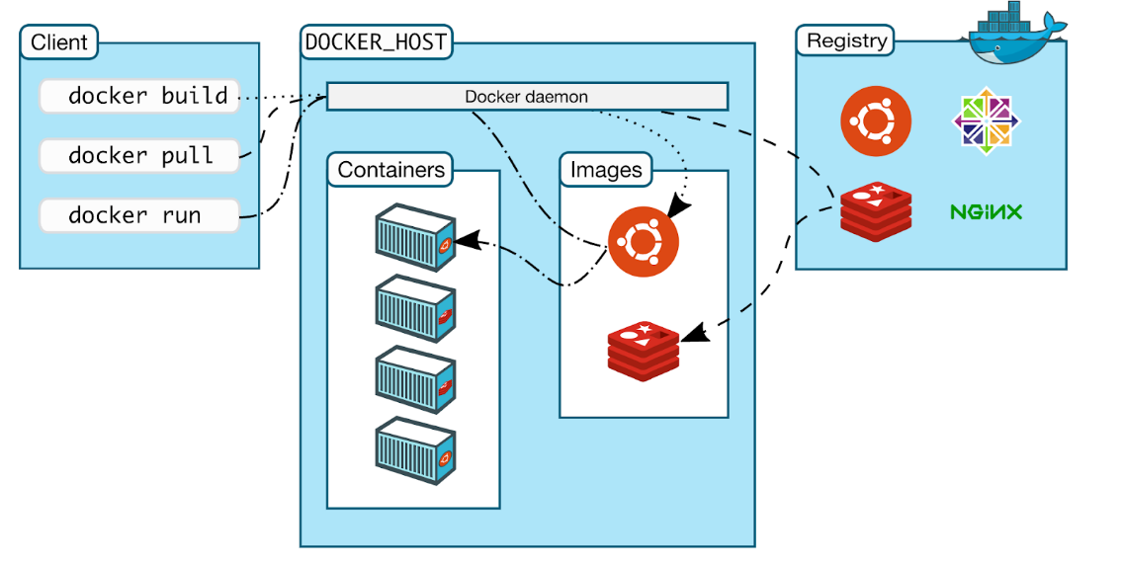
Docker Architecture
Docker is written in the Go programming language and takes advantage of several features of the Linux kernel to deliver its functionality.
Uses a technology called namespaces to provide the isolated workspace called the container.
Docker uses a client-server architecture.
Source: https://docs.docker.com/get-started/overview/

Slide 20
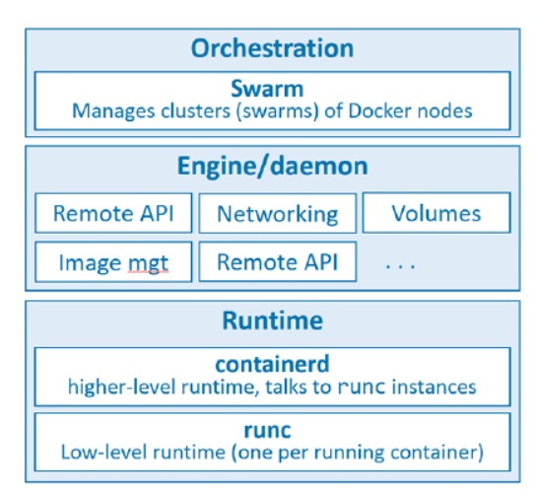
The runtime operates at the lowest level and is responsible for starting and stopping containers:
The low-level runtime is called runc
The higher-level runtime is called containerd
The Docker daemon (dockerd) sits above containerd and performs higher-level tasks
Docker also has native support for managing clusters of nodes running Docker.
Source: Docker Deep Dive, Nigel Poulton

Slide 21
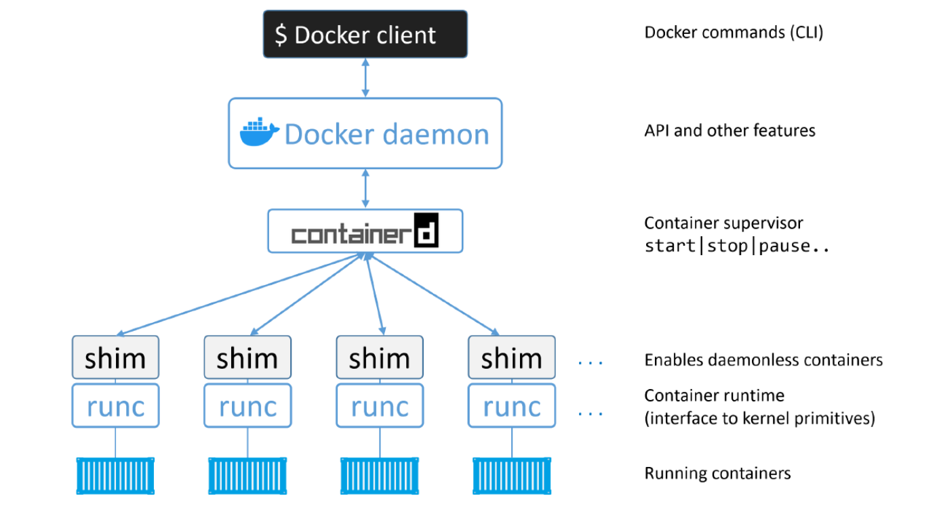
Source: Docker Deep Dive, Nigel Poulton

Slide 22
Containers

Slide 23
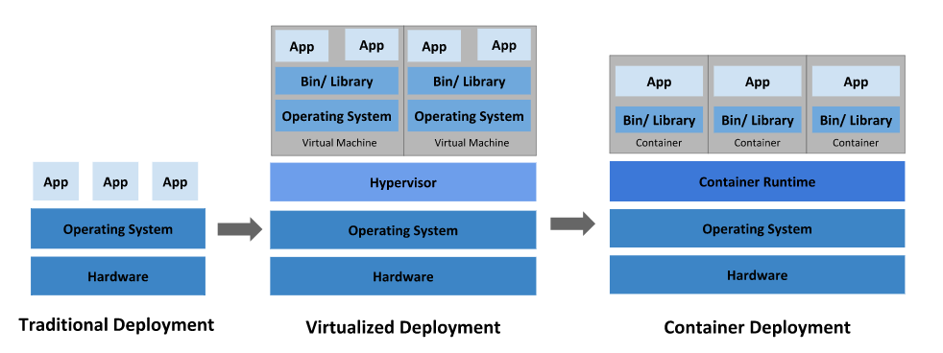
Containers History
Virtual Machines
Linux containers
Source: https://kubernetes.io/docs/concepts/overview/what-is-kubernetes/
Notes:
Motivacija:
Hardware je vedno cenejši in močnejši -> vedno bolj zahtevne aplikacije
Neizkoriščene zmogljivosti
Prostor v strežniških omarah je drag
Varovanje okolja
Zamudne in drage upravne naloge
Monitoring strojne opreme
Menjava pokvarjene opreme brez prekinitve delovanja sistema
Inštalacija in nadgradnje strežnikov so zahtevne
Backup

Slide 24
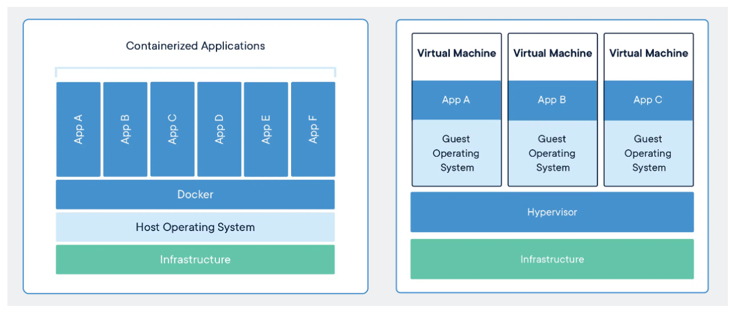
Containers vs Virtual Machines
Source: https://www.docker.com/resources/what-container/

Slide 25
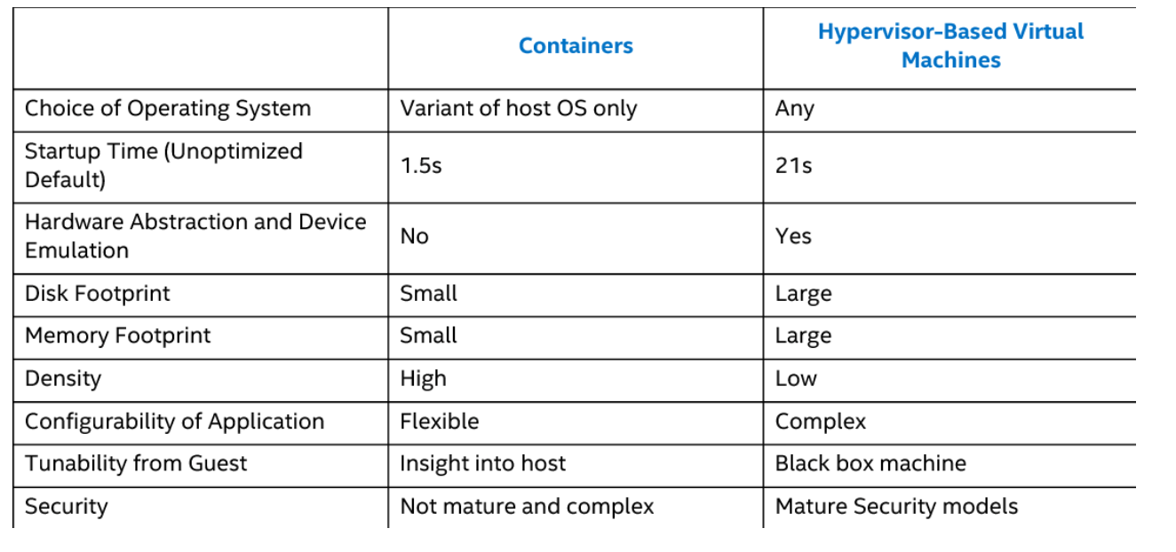

Slide 26
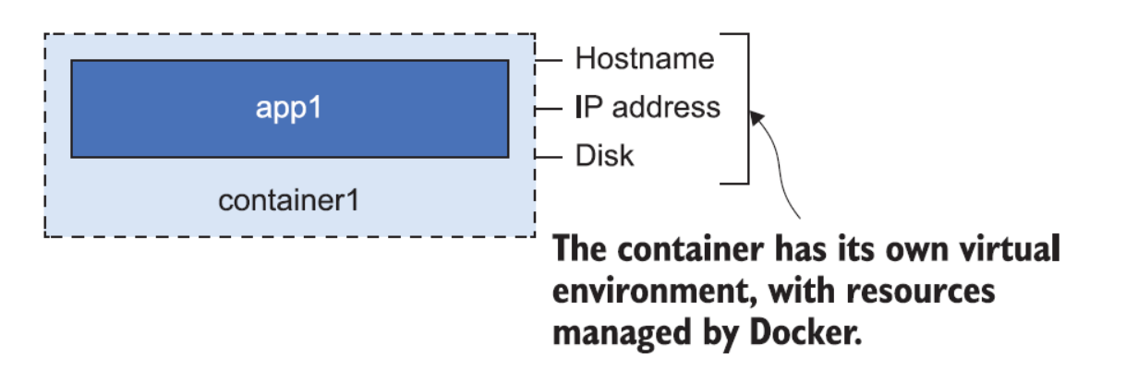
What is a container?
A Docker container is the same idea as a physical container — think of it like a box with an application in it
It has its own machine name and IP address, and it also has its own disk drive
The application inside the box can’t see anything outside the box
All containers share the CPU and memory of the computer, and they all share the computer’s operating system
Source: Learn Docker in a Month of Lunches, ELTON STONEMAN

Slide 27
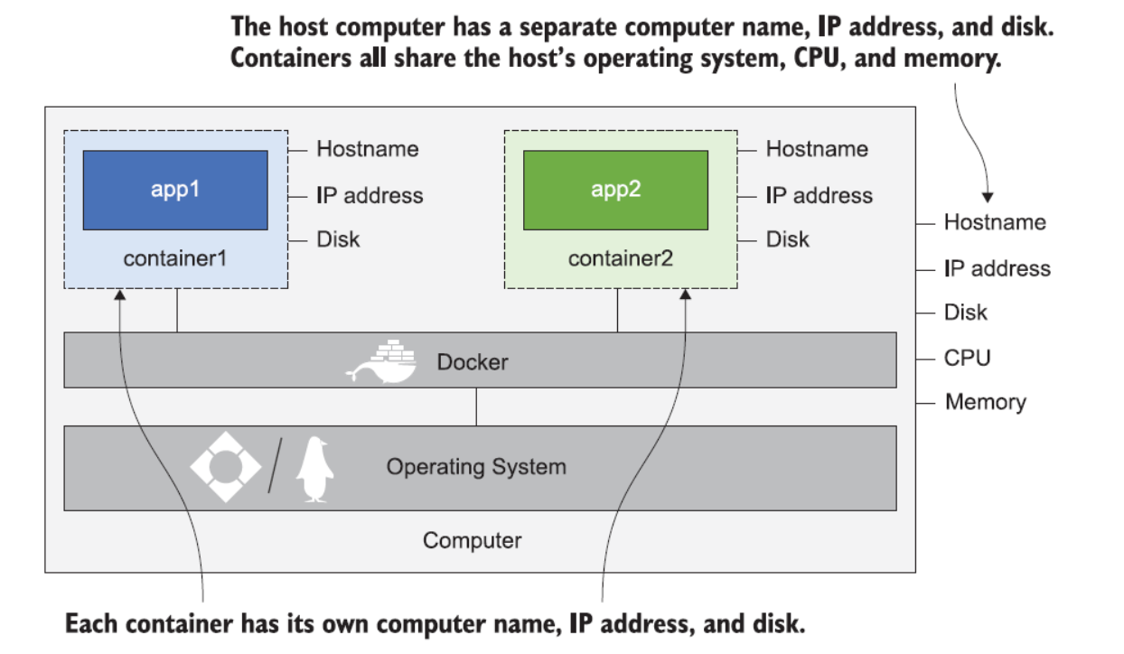
Source: Learn Docker in a Month of Lunches, ELTON STONEMAN

Slide 28
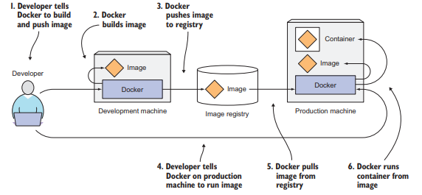
Starting a simple container
Web server example
Exploring the container filesystem and the container lifecycle
Stopping containers gracefully
Source: Marko Luksa - Kubernetes in Action-Manning Publications (2018)

Slide 29
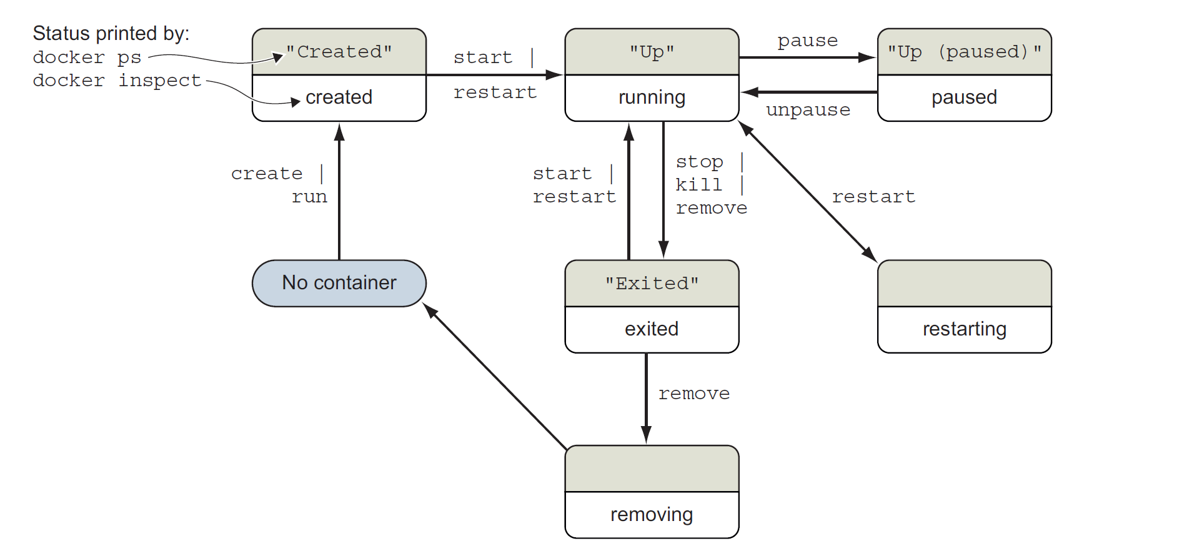

Slide 30
Docker Images

Slide 31
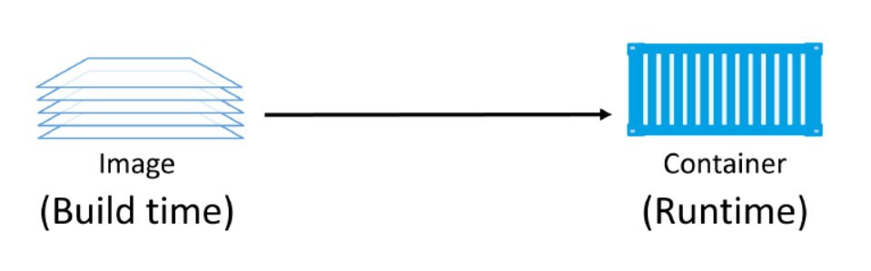
About Docker Images
A Docker image is a unit of packaging that contains everything required for an application to run.
application code
application dependencies
OS constructs.
You get Docker images by pulling them from an image registry.
Images are made up of multiple layers, images tend to be small
Source: Docker Deep Dive, Nigel Poulton

Slide 32
Images are usually small
The whole purpose of a container is to run a single application or service.
This results in small images stripped of all non-essential parts.
Image also don’t contain a kernel — all containers running on a Docker host share access to the host’s kernel.
Pulling images
A cleanly installed Docker host has no images in its local repository.
The process of getting images onto a Docker host is called pulling.

Slide 33
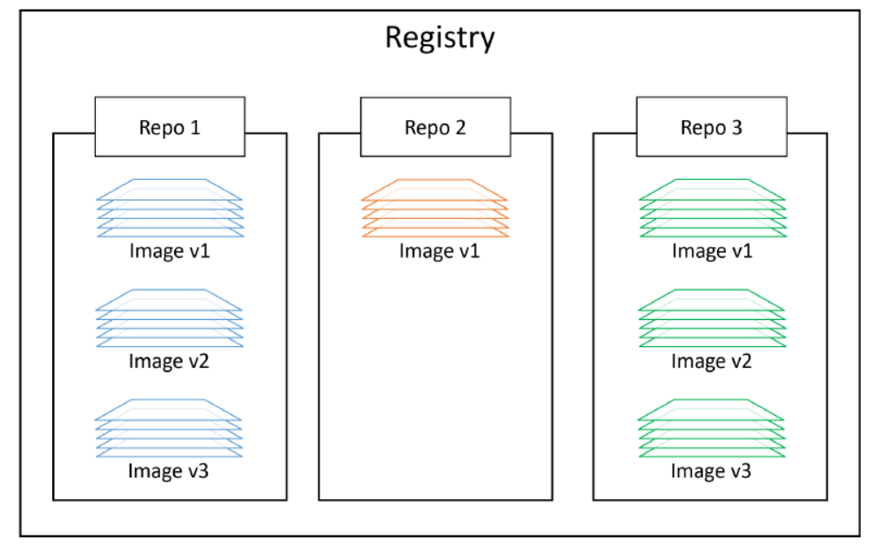
Image registries
We store images in centralised places called image registries.
The most common registry is Docker Hub.
Image registries contain one or more image repositories. In turn, image repositories contain one or more images.
Source: Docker Deep Dive, Nigel Poulton

Slide 34
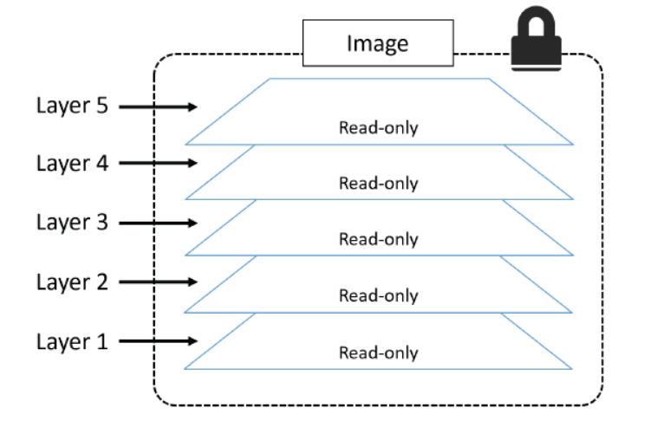
Images and layers
A Docker image is just a bunch of loosely-connected read-only layers, with each layer comprising one or more files.
Source: Docker Deep Dive, Nigel Poulton

Slide 35
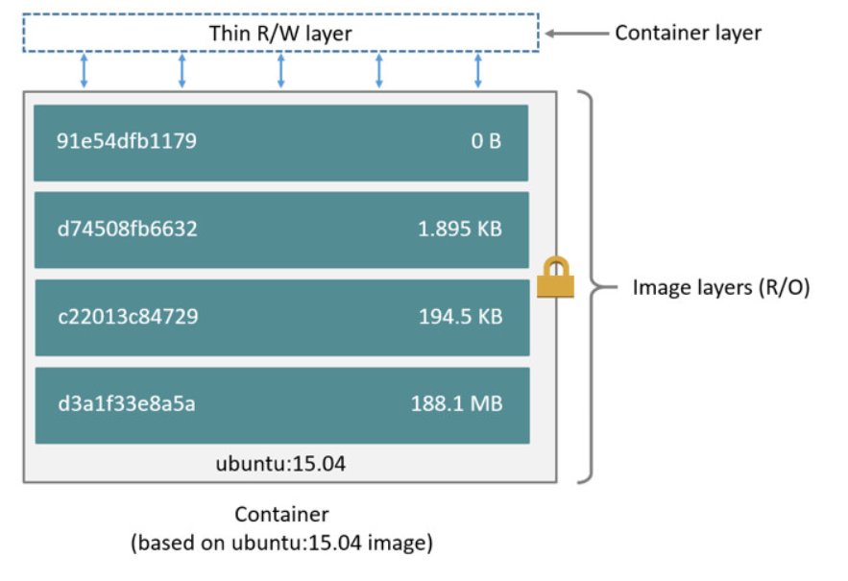
Source: Docker Deep Dive, Nigel Poulton

Slide 36
Docker Storage And Volumes

Slide 37
Introduction to Docker Storage And Volumes
Containers are a perfect runtime for stateless applications.
Stateful applications that persist data are becoming more and more important in the world of cloud-native and microservices applications.
There are two main categories of data — persistent and non-persistent.
And technologies that now exist make containers a viable choice for many stateful applications.

Slide 38
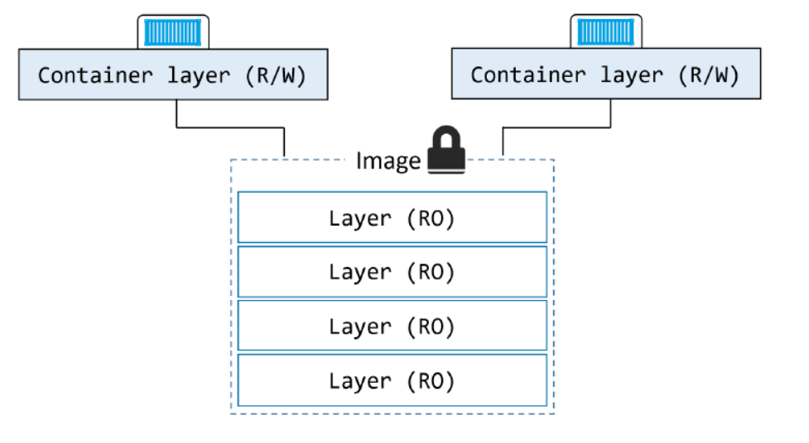
Containers and non-persistent data
Containers are designed to be immutable. It’s a best practice not to change the configuration of a container after it’s deployed. You shouldn’t log into a running container and make configuration changes.
Source: Docker Deep Dive, Nigel Poulton

Slide 39
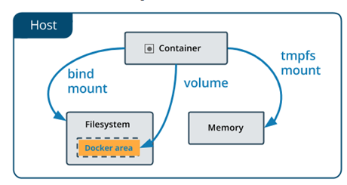
Choose the right type of mount
Volumes are stored in a part of the host filesystem which is managed by Docker.
Non-Docker processes should not modify this part of the filesystem.
Volumes are the best way to persist data in Docker.
Bind mounts may be stored anywhere on the host system.
They may even be important system files or directories.
Non-Docker processes on the Docker host or a Docker container can modify them at any time.
tmpfs mounts are stored in the host system’s memory only, and are never written to the host system’s filesystem.
Source: https://docs.docker.com/storage/

Slide 40
Docker Networking

Slide 41
Docker networking overview

Slide 43
Cloud-Native Architectures and Technologies
Ljubljana, september 2021

Slide 44
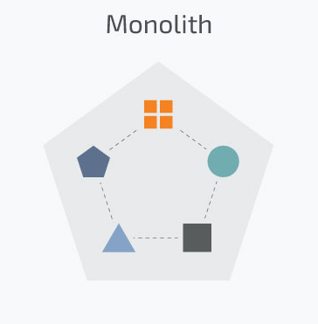
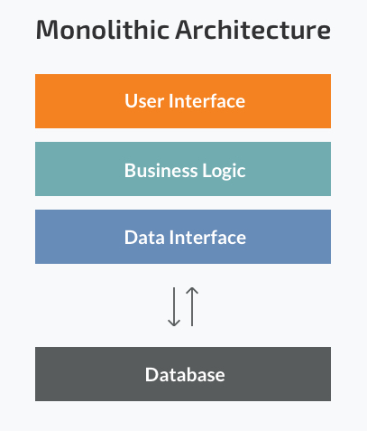
Traditional applications
Monolithic application
Years ago, most software applications were big monoliths
Built as a single and indivisible unit
Still widespread today
Challenges
Handling a huge code base
Adopting a new technology
Scaling
Lack of modularity
Deployment
Implementing new changes -> slow (entire application has to be rewritten)
Source: Microservices vs Monolith: which architecture is the best choice for your business? https://www.n-ix.com/microservices-vs-monolith-which-architecture-best-choice-your-business/

Slide 45
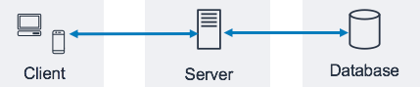
Client-side user interface, a server side-application, and a database.
Strengths
Less cross-cutting concerns (logging, handling, caching, and performance monitoring)
Easier debugging and testing
Simple to deploy (just one file or directory)
Simple to develop (knowledge – standard way of development)
MonolithFirst
Source: Three-Tier Architecture Overview - https://docs.aws.amazon.com/whitepapers/latest/serverless-multi-tier-architectures-api-gateway-lambda/three-tier-architecture-overview.html
Notes:
Strengths of the Monolithic Architecture
- Less cross-cutting concerns. Cross-cutting concerns are the concerns that affect the whole application such as logging, handling, caching, and performance monitoring. In a monolithic application, this area of functionality concerns only one application so it is easier to handle it.
- Easier debugging and testing. In contrast to the microservices architecture, monolithic applications are much easier to debug and test. Since a monolithic app is a single indivisible unit, you can run end-to-end testing much faster.
- Simple to deploy. Another advantage associated with the simplicity of monolithic apps is easier deployment. When it comes to monolithic applications, you do not have to handle many deployments – just one file or directory.
- Simple to develop. As long as the monolithic approach is a standard way of building applications, any engineering team has the right knowledge and capabilities to develop a monolithic application.

Slide 46
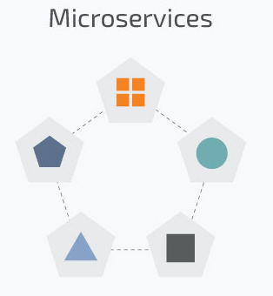
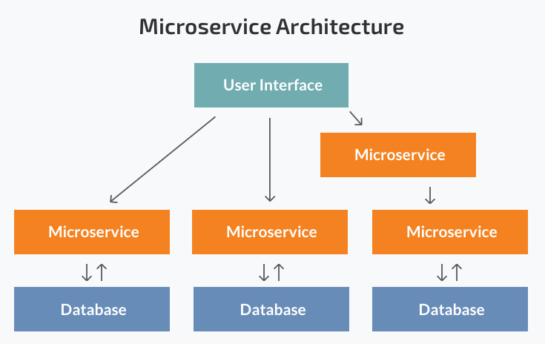
Microservices
Today, these big monolithic legacy applications are slowly being broken down into smaller, independently running components called microservices.
Source: Microservices vs Monolith: which architecture is the best choice for your business? https://www.n-ix.com/microservices-vs-monolith-which-architecture-best-choice-your-business/

Slide 47
These units carry out every application process as a separate service.
So all the services have their own logic and the database.
Components communicate with each other through defined methods called APIs.
Strengths:
Independent components
Easier understanding
Better scalability
Flexibility in choosing the technology
The higher level of agility
Weaknesses:
Extra complexity
System distribution
Cross-cutting concerns (configuration, logging, metrics, health checks)
Testing

Slide 48
Scaling monolithic apps
Running a monolithic application usually requires a small number of powerful servers that can provide enough resources for running the application.
To deal with increasing loads on the system:
vertically scale the servers (also known as scaling up) -> adding more CPUs, memory, and other server components
usually doesn’t require any changes to the app
gets expensive relatively quickly
in practice always has an upper limit
scale the whole system horizontally (scaling out) -> setting up additional servers and running multiple copies of an application
relatively cheap hardware-wise
require big changes in the application code (sometimes impossible)

Slide 49
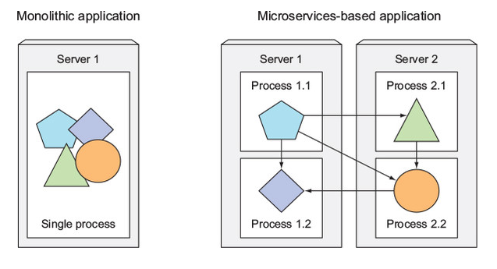
Splitting apps into microservices
Described problems have forced us to start splitting complex monolithic applications into smaller independently deployable components called microservices.
Each microservice:
runs as an independent process,
communicates with other microservices through simple, well-defined interfaces (APIs)
can be written in the language that’s most appropriate for implementing that specific microservice
Source: Marko Luksa - Kubernetes in Action-Manning Publications (2018)

Slide 50
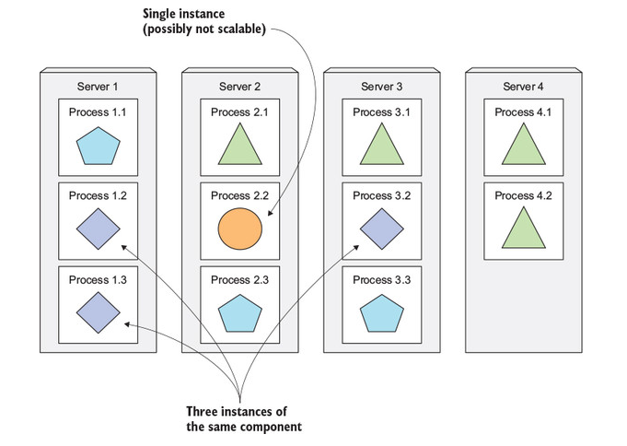
Scaling microservices
Scaling is done on a per-service basis.
you have the option of scaling only those services that require more resources
Splitting the app into microservices allows you to horizontally scale the parts that allow scaling out
Source: Marko Luksa - Kubernetes in Action-Manning Publications (2018)

Slide 51
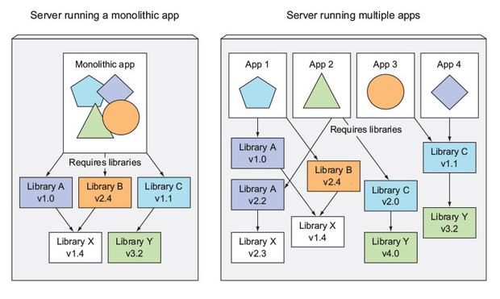
Microservices environment requirements
Components in a microservices architecture are also developed independently
common to have separate teams developing each component
different libraries and different versions of the same libraries
exact same environment during development, testing and in production -> container technologies
Source: Marko Luksa - Kubernetes in Action-Manning Publications (2018)

Slide 52
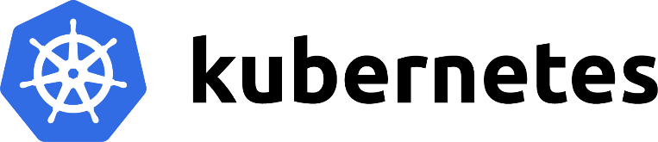
Kubernetes
Ljubljana, september 2021

Slide 53
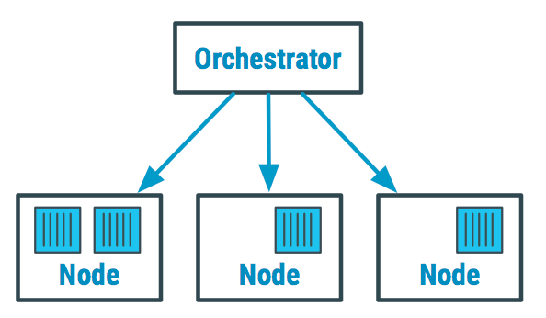
Orchestration
Containers give your microservice-based apps an ideal application deployment unit and self-contained execution environment.
need to deploy and manage hundreds or thousands of containers -> doing itmanually isn’t a scalable strategy.
Container orchestration automates the deployment, management, scaling, and networking of containers
Tools: Kubernetes, Docker Swarm, AWS Fargate
Source: https://devopedia.org/container-orchestration
Notes:
https://www.redhat.com/en/topics/automation/what-is-orchestration
https://www.redhat.com/en/topics/containers/what-is-container-orchestration

Slide 54


Kubernetes
https://kubernetes.io/
When your system grows, it becomes hard to manage all the components
Kubernetes is a portable, extensible, open-source platform for managing containerized workloads and services, that facilitates both declarative configuration and automation.
Rapidly growing ecosystem
Kubernetes originates from Greek, meaning helmsman or pilot.

Slide 55
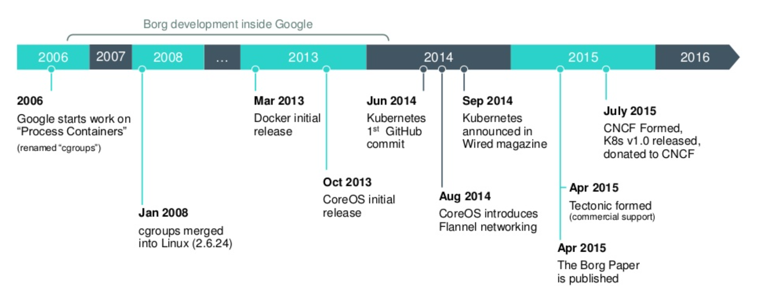
Origins
Google developed an internal system called Borg, that helped both application developers and system administrators manage those thousands of applications and services.
Borg and Omega were kept in secret for a whole decade.
In 2014 Google introduced Kubernetes, an open-source system based on the experience gained through Borg, Omega, and other internal Google systems.
Source: https://www.slideshare.net/egg9/kubernetes-introduction

Slide 56
Introduction
Kubernetes is a software system that allows you to easily deploy and manage containerized applications on top of it.
Relies on the features of Linux containers
Apps run in containers, they don’t affect other apps running on same server -> run applications for completely different organizations on the same hardware
maintain complete isolation of hosted applications
Thousands of computer nodes as if all those nodes were a single, enormous computer
Deploying applications through Kubernetes is always the same.
Kubernetes can be thought of as an operating system for the cluster.

Slide 57
Glavne značilnosti
Omogoča deklarativen opis stanj z visokonivojskimi koncepti
Kontejnerje samodejno razporeja na ustrezne gostitelje
Skrbi za vnovični zagon kontejnerjev
Prerazporeja kontejnerje v primeru izpada
Preverja vitalnost kontejnerjev in poskrbi za njihovo odstranitev, če se ti ne odzivajo
Omogoča samodejno horizontalno skaliranje kontejnerjev
Omogoča odkrivanje storitev
Progresivno posodabljanje aplikaciji
Omogoča hranjenje in upravljanje varnostnih podatkov in konfiguracijo aplikaciji
Samodejni priklop podatkovnih shramb

Slide 58
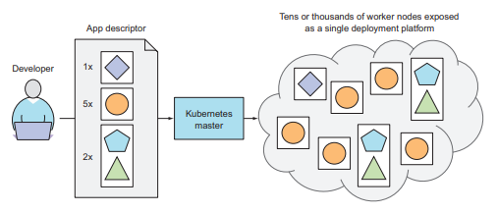
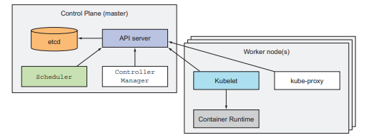
What Kubernetes does?
Master node and any number of worker nodes
Developer submits a list of apps to the master, Kubernetes deploys them to the cluster of worker nodes.
Vir: Marko Luksa - Kubernetes in Action-Manning Publications (2018)
Notes:
The developer can specify that certain apps must run together and Kubernetes will deploy them on the same worker node. Others will be spread around the cluster, but they can talk to each other in the same way, regardless of where they’re deployed.

Slide 59
Running an application in Kubernetes
package the application up into one or more container images
push those images to an image registry
post a description of your app to the Kubernetes API server
information such as the container image, how those components are related to each other, and which ones need to be run co-located
the API server processes your app’s description
the Scheduler schedules the specified groups of containers onto the available worker nodes
the Kubelet on those nodes then instructs the Container Runtime to pull the required container images and run the containers

Slide 60
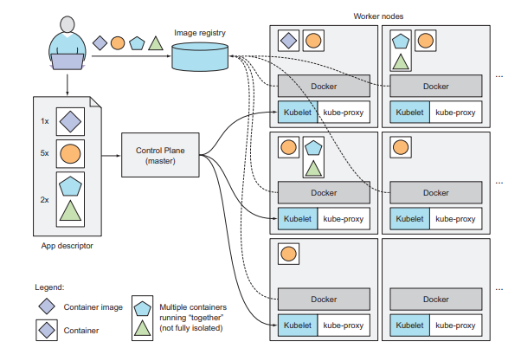
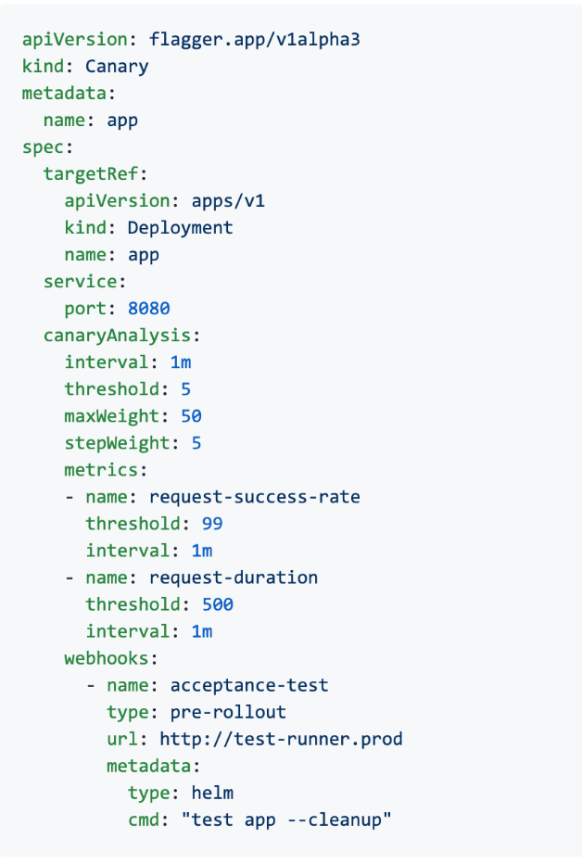
Vir: Marko Luksa - Kubernetes in Action-Manning Publications (2018)
Notes:
- Povemo za yaml

Slide 61

Benefits of using Kubernetes
Simplifying application deployment
exposes all its worker nodes as a single deployment platform
Achieving better utilization of hardware
Health checking and self-healing
Automatic scaling
Simplifying application development
Notes:
SIMPLIFYING APPLICATION DEPLOYMENT
Because Kubernetes exposes all its worker nodes as a single deployment platform, application developers can start deploying applications on their own and don’t need to know anything about the servers that make up the cluster. In essence, all the nodes are now a single bunch of computational resources that are waiting for applications to consume them. A developer doesn’t usually care what kind of server the application is running on, as long as the server can provide the application with adequate system resources. Certain cases do exist where the developer does care what kind of hardware the application should run on. If the nodes are heterogeneous, you’ll find cases when you want certain apps to run on nodes with certain capabilities and run other apps on others. For example, one of your apps may require being run on a system with SSDs instead of HDDs, while other apps run fine on HDDs. In such cases, you obviously want to ensure that particular app is always scheduled to a node with an SSD. Without using Kubernetes, the sysadmin would select one specific node that has an SSD and deploy the app there. But when using Kubernetes, instead of selecting a specific node where your app should be run, it’s more appropriate to tell Kubernetes to only choose among nodes with an SSD. You’ll learn how to do that in chapter 3

Slide 62
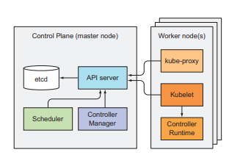
Kubernetes - architecture
A Kubernetes cluster is split into two parts:
The Kubernetes Control Plane
The (worker) nodes
The Control Plane is what controls and makes the whole cluster function.
The task of running your containers is up to the components running on each worker node.
Source: Marko Luksa - Kubernetes in Action-Manning Publications (2018)

Slide 63
Control Plane Components
etcd distributed persistent storage (etcd)
API server (kube-apiserver)
Scheduler (kube-scheduler)
Controller Manager (kube-controller-manager)
cloud-controller-manager
Worker Node Components
Kubelet
Kubernetes Service Proxy (kube-proxy)
Container Runtime (Docker, rkt, or others)
Add-on Components
DNS
Web UI (Dashboard)
Container Resource Monitoring
Cluster-level Logging
An Ingress controller
Notes:
https://kubernetes.io/docs/concepts/overview/components/

Slide 64
Kubernetes Components
A Kubernetes cluster consists of a set of worker machines, called nodes, that run containerized applications. Every cluster has at least one worker node.
In production environments, the control plane usually runs across multiple computers and a cluster usually runs multiple nodes, providing fault-tolerance and high availability.
The previously mentioned components all run as individual processes.
To get all the features Kubernetes provides, all these components need to be running.

Slide 65
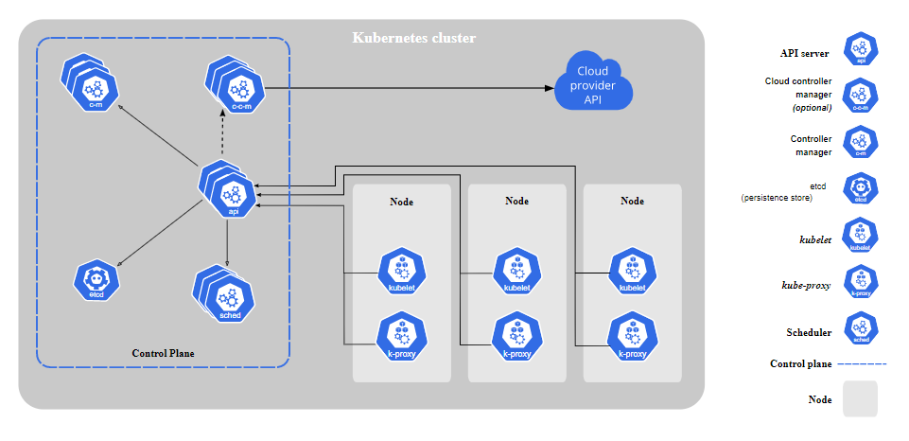
Vir: Kubernetes Components (https://kubernetes.io/docs/concepts/overview/components/)

Slide 66

etcd
consistent and highly-available key value store used as Kubernetes' backing store for all cluster data
you can run more than one etcd instance to provide both high availability
the number of etcd instances should be an odd number
the only component that talks to etcd directly is the Kubernetes API server
a more robust optimistic locking system
Validation
much simpler to replace it in the future
is the only place Kubernetes stores cluster state and metadata
Notes:
The only component that talks to etcd directly is the Kubernetes API server. All other components read and write data to etcd indirectly through the API server. This brings a few benefits, among them a more robust optimistic locking system as well as validation; and, by abstracting away the actual storage mechanism from all the other components, it’s much simpler to replace it in the future.

Slide 67
API server (kube-apiserver)
a control plane component that exposes the Kubernetes API
API server is the front end for the Kubernetes control plane
kube-apiserver is designed to scale horizontally (run several instances of kube-apiserver and balance traffic between those instances)
Kubernetes system components communicate only with the API server
used by all other components and by clients
it provides a CRUD (Create, Read, Update, Delete) interface for querying and modifying the cluster state over a RESTful API
performs validation of those objects, so clients can’t store improperly configured objects

Slide 68
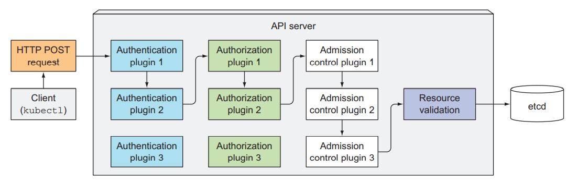
One of the API server’s clients is the command-line tool kubectl
creating a resource from a JSON file and make an HTTP POST request
authenticate the client sending the request (determines who is sending the request)
authorize whether the authenticated user can perform the requested action on the requested resource
validating and/or modifying the resource in the request with admission control plugins
API server then validates the object
Vir: Marko Luksa - Kubernetes in Action-Manning Publications (2018)

Slide 69
Scheduler (kube-scheduler)
watches for newly created Pods with no assigned node, and selects a node for them to run on
the Scheduler doesn’t instruct the selected node -> update the pod definition through the API server -> API server then notifies the Kubelet
you can write your own scheduling component and use that instead
Factors taken into account for scheduling decisions include:
individual and collective resource requirements,
hardware/software/policy constraints,
affinity and anti-affinity specifications,
data locality,
inter-workload interference,
deadlines
Notes:
https://kubernetes.io/docs/concepts/scheduling-eviction/kube-scheduler/
only a single instance of the Scheduler and the Controller Manager may be active at a given time—with the others in standby mode.

Slide 70
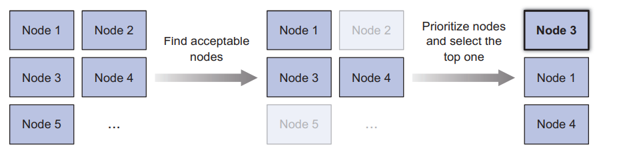
The default scheduling algorithm:
Filtering the list of all nodes to obtain a list of acceptable nodes the pod can be scheduled to
Prioritizing the acceptable nodes and choosing the best one.
If multiple nodes have the highest score, round-robin is used to ensure pods are deployed across all of them evenly.
Source: Marko Luksa - Kubernetes in Action-Manning Publications (2018)
Notes:
To determine which nodes are acceptable for the pod, the Scheduler passes each node through a list of configured predicate functions. These check various things such as ○ Can the node fulfill the pod’s requests for hardware resources? You’ll learn how to specify them in chapter 14. ○ Is the node running out of resources (is it reporting a memory or a disk pressure condition)? ○ If the pod requests to be scheduled to a specific node (by name), is this the node? ○ Does the node have a label that matches the node selector in the pod specification (if one is defined)? ○ If the pod requests to be bound to a specific host port (discussed in chapter 13), is that port already taken on this node or not? ○ If the pod requests a certain type of volume, can this volume be mounted for this pod on this node, or is another pod on the node already using the same volume? ○ Does the pod tolerate the taints of the node? Taints and tolerations are explained in chapter 16. ○ Does the pod specify node and/or pod affinity or anti-affinity rules? If yes, would scheduling the pod to this node break those rules? This is also explained in chapter 16

Slide 71
Controller Manager (kube-controller-manager)
Control Plane component that runs controller processes.
Logically, each controller is a separate process, but to reduce complexity, they are all compiled into a single binary and run in a single process.
The list of these controllers includes the:
Replication Manager (a controller for ReplicationController resources)
ReplicaSet, DaemonSet, and Job controllers
Deployment controller
StatefulSet controller
Node controller
Service controller
Endpoints controller
Namespace controller
PersistentVolume controller
Notes:
https://kubernetes.io/docs/concepts/architecture/controller/

Slide 72
there’s a controller for almost every resource you can create
Resources are descriptions of what should be running in the cluster
How ReplicationController works?
They watch the API server for changes to resources
each change that may affect the desired replica count or the number of matched pods
Creates new Pod manifests, posts them to the API server
lets the Scheduler and the Kubelet do their job of scheduling and running the pod
The Replication Manager performs its work by manipulating Pod API objects through the API server. This is how all controllers operate.
They don’t communicate with the Kubelets directly -> they don’t even know Kubelets exist

Slide 73
cloud-controller-manager
A Kubernetes control plane component that embeds cloud-specific control logic.
lets you link your cluster into your cloud provider's API
only runs controllers that are specific to your cloud provider
If you are running Kubernetes on your own premises, the cluster does not have a cloud controller manager
The following controllers can have cloud provider dependencies:
Node controller: For checking the cloud provider to determine if a node has been deleted in the cloud after it stops responding
Route controller: For setting up routes in the underlying cloud infrastructure
Service controller: For creating, updating and deleting cloud provider load balancers

Slide 74
Kubelet
An agent that runs on each node in the cluster. It makes sure that containers are running in a Pod.
The kubelet doesn't manage containers which were not created by Kubernetes.
Run pods based on:
pod manifests from the API server
pod manifest files in a specific local directory
This feature is used to run the containerized versions of the Control Plane components as pods

Slide 75
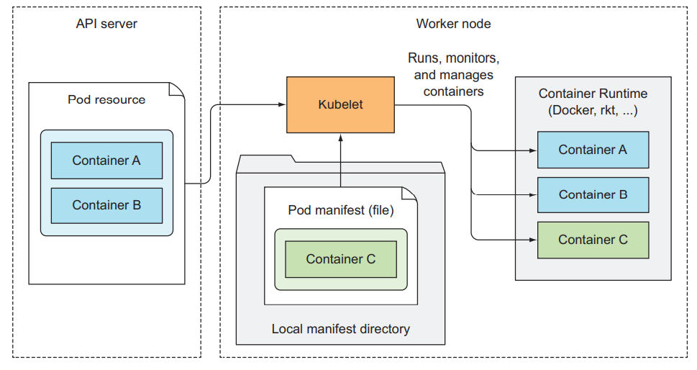
Source: Marko Luksa - Kubernetes in Action-Manning Publications (2018)

Slide 76
How is kubelet working?
initial job is to register the node it’s running on by creating a Node resource in the API server
continuously monitor the API server for Pods that have been scheduled to the node
start the pod’s containers
It does this by telling the configured container runtime to run a container from a specific container image
constantly monitors running containers
reports their status, events, and resource consumption to the API server
runs the container liveness probes, restarting containers when the probes fail
it terminates containers when their Pod is deleted from the API server and notifies the server that the pod has terminated

Slide 77
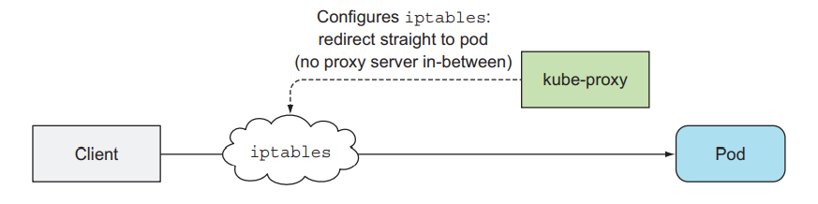
Kubernetes Service Proxy (kube-proxy)
kube-proxy is a network proxy that runs on each node in your cluster, implementing part of the Kubernetes Service concept.
Its purpose is to make sure clients can connect to the services you define through the Kubernetes API.
When a service is backed by more than one pod, the proxy performs load balancing across those pods.
kube-proxy maintains network rules on nodes. These network rules allow network communication to your Pods from network sessions inside or outside of your cluster.
kube-proxy uses the operating system packet filtering layer if there is one and it's available. Otherwise, kube-proxy forwards the traffic itself.
Source: Marko Luksa - Kubernetes in Action-Manning Publications (2018)
Notes:
https://betterprogramming.pub/k8s-a-closer-look-at-kube-proxy-372c4e8b090
https://www.tigera.io/blog/comparing-kube-proxy-modes-iptables-or-ipvs/

Slide 78
Container Runtimes
You need to install a container runtime into each node in the cluster so that Pods can run there.
The Open Container Initiative (OCI) has successfully standardized the concept of a container and container image in order to guarantee interoperability between runtimes
Kubernetes has added a Container Runtime Interface (CRI) to allow container runtimes to be pluggable underneath the Kubernetes orchestration layer
Common container runtimes with Kubernetes:
containerd
CRI-O
Docker (deprecated)
Notes:
https://www.infoq.com/articles/container-runtimes-kubernetes/
https://kubernetes.io/docs/setup/production-environment/container-runtimes/
https://kubernetes.io/blog/2016/12/container-runtime-interface-cri-in-kubernetes/

Slide 79

K3s - Lightweight Kubernetes
K3s is a fully compliant Kubernetes distribution with the following enhancements:
Packaged as a single binary (all Kubernetes control plane components is encapsulated in a single binary and process).
Lightweight storage backend.
Wrapped in simple launcher that handles a lot of the complexity of TLS and options.
Secure by default with reasonable defaults for lightweight environments.
Added powerful features: a local storage provider, a service load balancer, a Helm controller, and the Traefik ingress controller.

Slide 80
Why Use K3s
Perfect for Edge
highly available, certified Kubernetes distribution designed for production workloads in unattended, resource-constrained, remote locations or inside IoT appliances
Simplified & Secure
K3s is packaged as a single <40MB binary that reduces the dependencies and steps needed to install, run and auto-update a production Kubernetes cluster
Optimized for ARM
Both ARM64 and ARMv7 are supported with binaries and multiarch images available for both (e.g. Raspberry Pi).

Slide 81
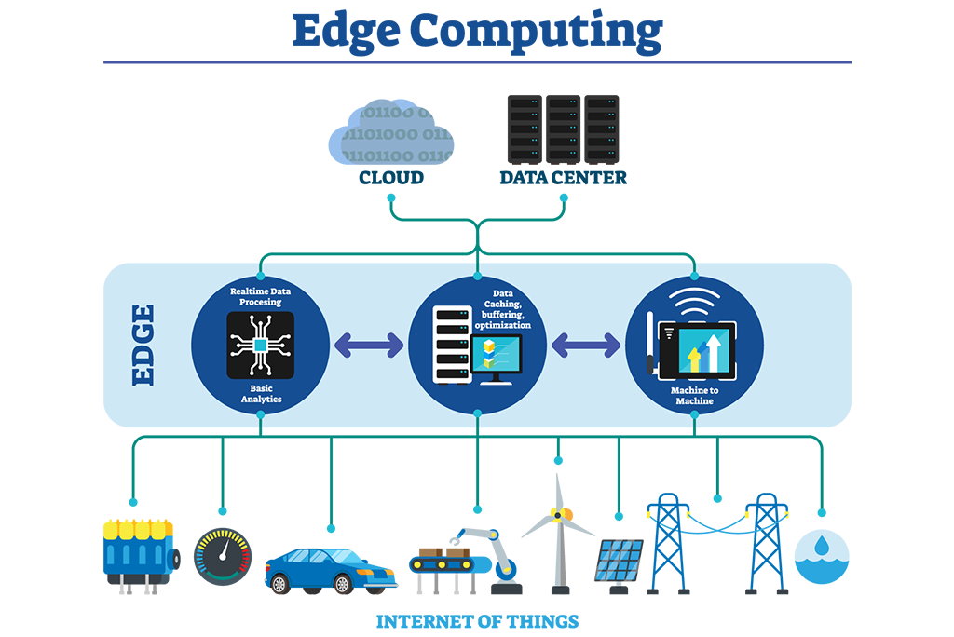


Usage
Edge
IoT
CI
Development
ARM
Embedding K8s
Learning
Notes:
https://sum-tech.de/wp-content/uploads/2020/03/photo_2020-03-06_15-39-40-225x300.jpg
https://media.kasperskycontenthub.com/wp-content/uploads/sites/43/2018/09/18085355/abstract-iot-1000x600.jpg
https://forum.huawei.com/enterprise/en/data/attachment/forum/202104/30/020806ifrefr5ez7rnvrjx.png?edge%203%20ieee.png

Slide 82

Architecture
Vir: https://k3s.io/images/how-it-works-k3s.svg

Slide 83
Single-server Setup with an Embedded DB
A server node is defined as a machine (bare-metal or virtual) running the k3s server command.
A worker node is defined as a machine running the k3s agent command.
Cluster that has a single-node K3s server with an embedded SQLite database
Each agent node is registered to the same server node.
A K3s user can manipulate Kubernetes resources by calling the K3s API on the server node.

Slide 84

Vir: https://rancher.com/docs/img/rancher/k3s-architecture-single-server.png

Slide 85
High-Availability K3s Server with an External DB
Where uptime of the Kubernetes control plane is critical, you can run K3s in an HA configuration.
An HA K3s cluster is comprised of:
Two or more server nodes that will serve the Kubernetes API and run other control plane services
An external datastore - etcd3, MySQL, Postgres (as opposed to the embedded SQLite datastore used in single-server setups)

Slide 86

Vir: https://rancher.com/docs/img/rancher/k3s-architecture-ha-server.png

Slide 87
Installation
K3s provides an installation script that is a convenient way to install it as a service on systemd or openrc based systems. This script is available at https://get.k3s.io. To install K3s using this method, just run:
curl -sfL https://get.k3s.io | K3S_KUBECONFIG_MODE=644 sh -
The K3s service will be configured to automatically restart after node reboots or if the process crashes or is killed
Additional utilities will be installed, including kubectl, crictl, ctr, k3s-killall.sh, and k3s-uninstall.sh
A kubeconfig file will be written to /etc/rancher/k3s/k3s.yaml and the kubectl installed by K3s will automatically use it
Notes:
https://rancher.com/docs/k3s/latest/en/quick-start/

Slide 88

First app
Vir: Marko Luksa - Kubernetes in Action-Manning Publications (2018)

Slide 89

Pods
Pod is a co-located group of containers and represents the basic building block in Kubernetes.
You always deploy and operate on a pod of containers.
it’s common for pods to contain only a single container
When a pod does contain multiple containers, all of them are always run on a single worker node
Vir: Marko Luksa - Kubernetes in Action-Manning Publications (2018)

Slide 90
Containers are designed to run only a single process per container
You need to run each process in its own container. That’s how Docker and Kubernetes are meant to be used.
A pod of containers allows you to run closely related processes together and provide them with (almost) the same environment as if they were all running in a single container, while keeping them somewhat isolated
they all share the same hostname and network interfaces
Can run under the same IPC namespace
the file system of each container is fully isolated from other containers

Slide 91


Containers in a pod share the same IP address and port space
processes running in containers of the same can’t bind to the same port numbers
Container can communicate with other containers in the same pod through localhost
All pods in a Kubernetes cluster reside in a single flat, shared, network-address space.
Vir: Marko Luksa - Kubernetes in Action-Manning Publications (2018)

Slide 92
Organizing containers across pods
run only one application in each pod
pods have almost no resource overhead
Example: simple system composed of a front-end web server and a back-end database
you shouldn’t run them in the same pod
they can easily communicate over the network
improving the utilization of your hardware
horizontal scaling (basic unit of scaling) –> Kubernetes doesn’t replicate containers within a pod. It replicates the entire pod
different components have different scaling requirements
Relational databases, usually can’t be scaled
Decide when to place containers in a single pod:
Do these containers have to run on the same host? yes
Do I want to manage them as a single unit? yes
Do they form a unified whole instead of being independent components? yes
Do they have to be scaled together? yes
Can a single node meet their combined resource needs? yes

Slide 93

Vir: Marko Luksa - Kubernetes in Action-Manning Publications (2018)

Slide 94


Sidecar containers
multiple containers into a single pod -> when the application consists of one main process and one or more complementary processes
sidecar containers include log rotators and collectors, data processors, communication adapters, and others
Vir: Marko Luksa - Kubernetes in Action-Manning Publications (2018)
Notes:
Vedno strmimo k temu, da kontejnerje zaženemo v ločenih podih.

Slide 95

V splošnem strokov nikoli ne kreiramo neposredno.
Vir: Marko Luksa - Kubernetes in Action-Manning Publications (2018)
Notes:
Kreiramo jih z uporabo namestitvenih enot tipa namestitev (Deployment), ki doprinesejo:
•zmožnost samodejne vzpostavitve ob izpadu stroka,
•upravljanje replik in
•“rollout” namestitve in posodobitve.

Slide 96

Primer: namestitev stroka
Namestitev
kubectl apply -f kubia-manual.yaml
Pridobitev informaciji o strokih
kubectl get pod kubia-manual -o yaml
kubectl get pods
Pridobitev dnevnikov (logiranja)
kubectl logs kubia-manual
Pošiljanje zahtevkov na strok
Vir: Marko Luksa - Kubernetes in Action-Manning Publications (2018)

Slide 97

Labels (označbe)
Omogočajo organizacijo Kubernetes objektov
Poljuben par ključ-vrednost
Omogočajo izbiranje gostitelja za namestitev
Vir: Marko Luksa - Kubernetes in Action-Manning Publications (2018)
Notes:
For example, with microservices architectures, the number of deployed microservices
can easily exceed 20 or more. Those components will probably be replicated
(multiple copies of the same component will be deployed) and multiple versions or
releases (stable, beta, canary, and so on) will run concurrently. This can lead to hundreds
of pods in the system. Without a mechanism for organizing them, you end up
with a big, incomprehensible mess, such as the one shown in figure 3.6. The figure
shows pods of multiple microservices, with several running multiple replicas, and others
running different releases of the same microservice.

Slide 98

Vir: Marko Luksa - Kubernetes in Action-Manning Publications (2018)

Slide 99
Ustavitev in odstranjevanje strokov
Odstranjevanje stroka po imenu:
kubectl delete pod <POD_NAMES>
Odstranjevanje s pomočjo oznake Label
kubectl delete pod <POD_NAMES> -l <KEY:VALUE>
Odstranitev vseh virov (razen objekta Secret)
kubectl delete all –all

Slide 100
Zdravje strokov
Strokov v praksi ne uporabljamo direktno -> uporabimo drugačne tipe virov (ReplicationControllers, Deployments)
Stroki niso odporni na:
napake v času razporejanja (scheduling)
izpad gostitelja,
In drugih napak zaradi vzdrževanja ali pomanjkanja virov.
V primeru da kontejner v stroku odpove, ga Kubelet ponovno zažene
Nekatere aplikacije nehajo delovati, brez da bi se proces zaustavil (memory leak, infinite loop, deadlock)
Moramo preveriti zdravje od zunaj

Slide 101
Liveness probes
Omogočajo preverjanje ali je kontejner še živ
Lahko jo definiramo za vsak kontejner posebej
Kubernetes periodično preverja stanje in ponovno zažene kontejner v primeru, da Liveness Probe ne zazna delovanja aplikacije
Obstajajo tudi Rediness probe (več o tem kasneje)
Omogočajo tri mehanizme zaznavanja:
HTTP GET probe
TCP Socket probe
Exec probe
V produkcijskih okoljih je praksa vedno definirati Liveness probe
Izpostavimo URL path /health -> preverimo notranji status vitalnih komponent aplikacije ob klicu
Potrebujemo mehanizem, ki poskrbi za zagon vseh strokov ob odpovedi gostitelja

Slide 102
ReplicationControllers (replikacijski nadzornik)
https://kubernetes.io/docs/concepts/workloads/controllers/replicationcontroller/
Replikacijski nadzornik (Replication Controller) zagotovi, da v nekem trenutku teče zahtevano število replik nekega stroka.
Če je strokov preveč, replikacijski nadzornik poskrbi za odstranitev odvečnih, če jih je premalo, poskrbi za zagon preostalih.
Stroki, ki jih ustvari replikacijski nadzornik, so samodejno nadomeščeni v primeru:
izpada zaradi napake pri delovanju,
da je strok pobrisan ali
je bil ustavljen.

Slide 103

Vir: Marko Luksa - Kubernetes in Action-Manning Publications (2018)

Slide 104

Constantly monitors the list of running pods and makes sure the actual number of pods of a “type” always matches the desired number
If too few such pods are running, it creates new replicas from a pod template.
If too few such pods are running, it creates new replicas from a pod template.
Vir: Marko Luksa - Kubernetes in Action-Manning Publications (2018)

Slide 105
Replica Set (replikacijski niz)
Replikacijski niz (RS) nadomešča replikacijski nadzornik (RC).
Večinoma jih ne kreiramo direktno, ampak z uporabo Deployment vira
https://kubernetes.io/docs/concepts/workloads/controllers/replicaset/
Replikacijski niz uporabimo v primeru:
ko imamo zahtevo, da v določenem trenutku teče določeno število podov,
ni potrebe po posodobitvah.
Razlika med RS in RC zajema
podporo za selector
RS podpira selector na osnovi set ov.
RC podpira selector le na osnovi enakosti
podporo za rolling update
V primeru potrebe je priporočena uporaba namestitvene enote tipa namestitev, ki za razliko od RS omogoča deklarativno nadgradnjo

Slide 106


DaemonSets
Run on each and every node in the cluster exactly one instance of the pod
Infrastructure-related pods that perform system-level operations (log collector, resource monitor…)
Source: Marko Luksa - Kubernetes in Action-Manning Publications (2018)
Notes:
Outside of Kubernetes, such processes would usually be started through system init scripts or the systemd daemon during node boot up.
If a node goes down, the DaemonSet doesn’t cause the pod to be created elsewhere.
But when a new node is added to the cluster, the DaemonSet immediately deploys a new pod instance to it.
A DaemonSet deploys pods to all nodes in the cluster, unless you specify that the pods should only run on a subset of all the nodes.

Slide 107

Primer: DaemonSet – SSD monitor
Želimo namestiti aplikacijo, ki monitorira SSD na vse tiste gostitelje, ki podpirajo SSD
Vir: Marko Luksa - Kubernetes in Action-Manning Publications (2018)

Slide 108

Jobs / CronJob
Allows you to run a pod whose container isn’t restarted when the process running inside finishes successfully.
In the event of a node failure, the pods on that node that are managed by a Job will be rescheduled to other nodes.
Jobs are useful for ad hoc tasks, where it’s crucial that the task finishes properly.
CronJob resource is useful for jobs that need to be run at a specific time in the future or repeatedly in the specified interval.
Source: Marko Luksa - Kubernetes in Action-Manning Publications (2018)

Slide 109
Service
Pods will usually respond to HTTP requests coming either from other pods inside the cluster or from clients outside the cluster.
Specifying the exact IP address or hostname of the server providing the service in the client’s configuration files wouldn’t work in Kubernetes:
Pods are ephemeral
Kubernetes assigns an IP address to a pod after the pod has been scheduled to a node and before it’s started
Horizontal scaling means multiple pods may provide the same service
To solve these problems, Kubernetes provides another resource type - Services
Notes:
https://kubernetes.io/docs/concepts/services-networking/service/

Slide 110

A Kubernetes Service is a resource you create to make a single, constant point of entry to a group of pods providing the same service (ClusterIP).
The IP address and port never change while the service exists.
Connections are routed to one of the pods backing that service.
Source: Marko Luksa - Kubernetes in Action-Manning Publications (2018)

Slide 111

Primer: ustvarjanje storitve
3 ReplicaSet stroki in Service
Vir: Marko Luksa - Kubernetes in Action-Manning Publications (2018)

Slide 112

Vir: Marko Luksa - Kubernetes in Action-Manning Publications (2018)

Slide 113

Primeri povezav:
večim strokom z enako storitvijo dodelimo enoten IP, ki je dosegljiv ostalim strokom znotraj gruče (ClusterIP)
izpostavimo storitve izven gruče preko storitve (externalName)
Izpostavimo storitev zunanjim odjemalcem:
Vir: Marko Luksa - Kubernetes in Action-Manning Publications (2018)

Slide 114
NodePort - Vsak gostitelj v gruči odpre vrata in usmeri zunanji promet iz teh vrat na konfigururano storitev. Storitev je na voljo na vratih vseh gostiteljev.
LoadBalancer - Storitev je dosegljiva preko namenskega load balancer-ja, zagotovljenega s strani ponudnika oblačnih storitev. Ta usmeri promet na vrata vseh gostiteljev v gruči.
Ingress - povsem drugačni mehanizem za izpostavljanje storitev preko enega naslova IP. Deluje na omrežnem nivoju 7 (HTTP) in ponuja več možnosti od ostalih storitev (omrežni nivo 4).

Slide 115

NodePort service
Vir: Marko Luksa - Kubernetes in Action-Manning Publications (2018)

Slide 116

LoadBalancer service
Vir: Marko Luksa - Kubernetes in Action-Manning Publications (2018)

Slide 117

Ingress
Vir: Marko Luksa - Kubernetes in Action-Manning Publications (2018)

Slide 118

Vir: Marko Luksa - Kubernetes in Action-Manning Publications (2018)

Slide 119


Deployment (namestitev)
https://kubernetes.io/docs/concepts/workloads/controllers/deployment/
omogoča deklarativno posodabljanje strokov in replikacijskih nizov
Možnosti posodobitev:
RollingUpdate (ko lahko imamo obe verziji aplikacije zagnane naenkrat)
Recreate (ko dve različni verziji aplikaciji ne morejo biti zagnani vzporedno)
Vir: Marko Luksa - Kubernetes in Action-Manning Publications (2018)

Slide 120

Vir: Marko Luksa - Kubernetes in Action-Manning Publications (2018)

Slide 121

Vir: Marko Luksa - Kubernetes in Action-Manning Publications (2018)

Slide 122
Upravljanje z viri
Brez omejitev lahko strok porabi vse vire, ki so mu na voljo
Specificiramo lahko CPU in pomnilnik za vsak kontejner v stroku
Specifikacija virov vpliva na razporejanje strokov
requests -> minimalna količina virov, ki jih strok potrebuje
limits -> maksimalna poraba virov za posamezen strok
V primeru, da na gostitelju ni dovolj virov glede na zahteve, scheduler ne bo namestil stroka na tega gostitelja

Slide 123


Vir: Marko Luksa - Kubernetes in Action-Manning Publications (2018)

Slide 124
Automatic scaling
Horizontalno vs vertikalno skaliranje
Možno ročno skaliranje preko replicas polja
Ni praktično ker moremo v naprej poznati obremenitev aplikaicje
Kubernetes omogoča avtomatsko skaliranje strokov ko zazna povečano CPU porabo
V oblačni infrastrukturi je možno tudi skaliranje gostiteljev
Horizontal pod autoscaling
skaliranje števila replik stroka
skaliramo lahko glede na CPU, pomnilnik, zahtevki na sekundo
Vertical pod autoscaling
ni še enostavne podpore
Horizontal scaling of cluster nodes
avtomatsko skaliranje števila gostiteljev

Slide 125

Vir: Marko Luksa - Kubernetes in Action-Manning Publications (2018)

Slide 126
Volumes
https://kubernetes.io/docs/concepts/storage/volumes/
Omogočajo kontejnerjem v stroku dostop do zunanjega prostora za shranjevanje podatkov in/ali deljenje prostora za shranjevanje med kontejnerji.
Privzeto si procesi znotraj stroka ne delijo datotečnega sistema.
Datotečni sistem izhaja iz slike kontejnerja.
Vir volumes je del stroka.

Slide 127


Vir: Marko Luksa - Kubernetes in Action-Manning Publications (2018)

Slide 128
Volume types
emptyDir - A simple empty directory used for storing transient data.
hostPath - Used for mounting directories from the worker node’s filesystem into the pod.
gitRepo - A volume initialized by checking out the contents of a Git repository.
nfs - An NFS share mounted into the pod.
gcePersistentDisk (Google Compute Engine Persistent Disk), awsElasticBlockStore (Amazon Web Services Elastic Block Store Volume), azureDisk (Microsoft Azure Disk Volume) - Used for mounting cloud provider-specific storage.
configMap, secret, downwardAPI - Special types of volumes used to expose certain Kubernetes resources and cluster information to the pod.

Slide 129

PersistentVolumes/PersistentVolumeClaims
Vir: Marko Luksa - Kubernetes in Action-Manning Publications (2018)

Slide 130

Vir: Marko Luksa - Kubernetes in Action-Manning Publications (2018)

Slide 131

Dynamic PersistentVolume provisioning
Vir: Marko Luksa - Kubernetes in Action-Manning Publications (2018)

Slide 132

Konfiguracija aplikaciji
Aplikacijo konfigururamo preko:
argumentov v ukazni vrstici
konfiguracijske datoteke
okoljskih spremenljivk
Vir za shranjevanje konfiguracije v Kubernetes-u imenujemo ConfigMap
Za shranjevanje občutljive konfiguracije Kubernetes ponuja vir Secret
Vir: Marko Luksa - Kubernetes in Action-Manning Publications (2018)

Slide 133


ConfigMap
https://kubernetes.io/docs/concepts/configuration/configmap/
Objekt, ki omogoča ločitev konfiguracijskih možnosti
Preslikava par ključ - vrednost
Lahko preslikamo tudi celotne konfiguracijske datoteke
Vir: Marko Luksa - Kubernetes in Action-Manning Publications (2018)

Slide 134
Secret
https://kubernetes.io/docs/concepts/configuration/secret/
Včasih imamo konfiguracijo z občutljivimi podatki, ki jo želimo želimo varno uporabiti
Preslikava par ključ - vrednost
Uporabimo jih na isti način kot ConfigMaps
https://kubernetes.io/docs/concepts/configuration/secret/#risks
A secret is only sent to a node if a Pod on that node requires it. The kubelet stores the secret into a tmpfs so that the secret is not written to disk storage. Once the Pod that depends on the secret is deleted, the kubelet will delete its local copy of the secret data as well.
On most Kubernetes distributions, communication between users and the API server, and from the API server to the kubelets, is protected by SSL/TLS. Secrets are protected when transmitted over these channels.

Slide 135

Vir: Marko Luksa - Kubernetes in Action-Manning Publications (2018)

Slide 136

Jobs / CronJob
https://kubernetes.io/docs/concepts/workloads/controllers/job/
Omogočajo zagon strokov z enim končnim opravilom
Primer: prenos in obdelava končne množice podatkov
Vir: Marko Luksa - Kubernetes in Action-Manning Publications (2018)

Slide 137
Nasveti
Web UI (Dashboard)
Connect a Front End to a Back End Using a Service
Unofficial Kubernetes

Slide 138
Vabljeni k sodelovanju!
info@ltfe.org
+386 1 476 8988
www.ltfe.org

